Slide 1
CELLULAR TELEPHONY
Cellular telephony is designed to provide communications between two moving units, called mobile stations (MSs), or between one mobile unit and one stationary unit, often called a land unit.
Topics discussed in this section:
Frequency-Reuse Principle Transmitting
Receiving
Roaming
First Generation
Second Generation
Third Generation

Slide 2
CELLULAR TELEPHONY
To make this tracking possible, each cellular service area is divided into small regions called cells.
Each cell contains an antenna and is controlled by a solar or AC powered network station, called the base station (BS).
Each base station, in tum, is controlled by a switching office, called a mobile switching center (MSC).
It is a computerized center that is responsible for connecting calls, recording call information, and billing.
Cell size is not fixed and can be increased or decreased depending on the population of the area.
The transmission power of each cell is kept low to prevent its signal from interfering with those of other cells.

Slide 3
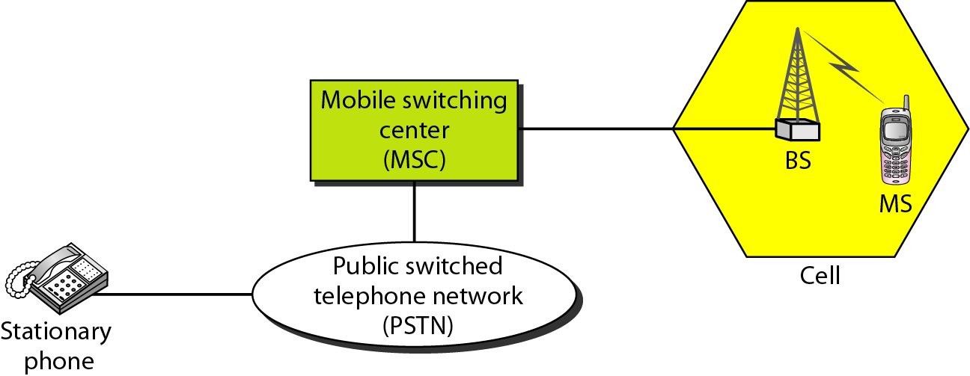
Figure 16.1 Cellular system

Slide 4
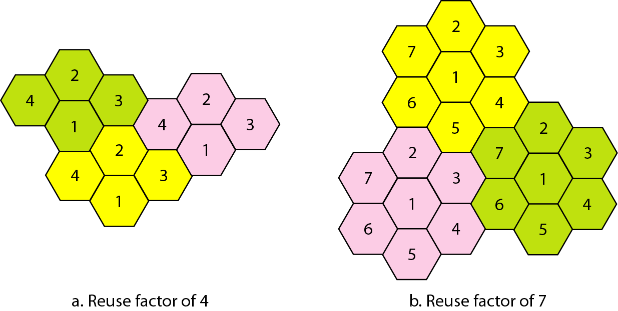
Frequency reuse patterns
the set of frequencies available is limited, and frequencies need to be reused
frequency reuse pattern is a configuration of N cells, N being the reuse factor

Slide 5
Transmitting:
To place a call from a mobile station, the caller enters a code of 7 or 10 digits (a phone
number) and presses the send button.
The mobile station then scans the band, seeking a setup channel with a strong signal, and sends the data (phone number) to the closest base station using that channel.
The base station relays the data to the MSC.
The MSC sends the data on to the telephone central office.
If the called party is available, a connection is made and the result is relayed back to the MSC.
At this point, the MSC assigns an unused voice channel to the call, and a connection is established.
The mobile station automatically adjusts its tuning to the new channel, and communication can begin.
Receiving
When a mobile phone is called, the telephone central office sends the number to the MSC.
The MSC searches for the location of the mobile station by sending query signals to each cell in a process called paging.
Once the mobile station is found, the MSC transmits a ringing signal and, when the mobile station answers, assigns a voice channel to the call, allowing voice communication to begin.
HandoFF:
the MSC monitors the level of the signal every few seconds.
The MSC then changes the channel carrying the call (hands the signal off from the old channel to a new one).
Hard Handoff: communication must first be broken with the previous base station
Soft Handoff
Roaming:
Roaming means, in principle, that a user can have access to communication or can be reached where there is coverage.
Neighboring service providers can providevextended coverage through a roaming contract.

Slide 6
First Generation: voice communication using analog signals.
Advanced Mobile Phone System (AMPS) is an analog cellular phone system using FDMA.
ISM 800-MHz band.
The system uses two separate analog channels, one for forward (base station to mobile station) communication and one for reverse (mobile station to base station) communication.
The band between 824 and 849 MHz carries reverse communication; the band between 869 and 894 MHz carries forward communication

Slide 7
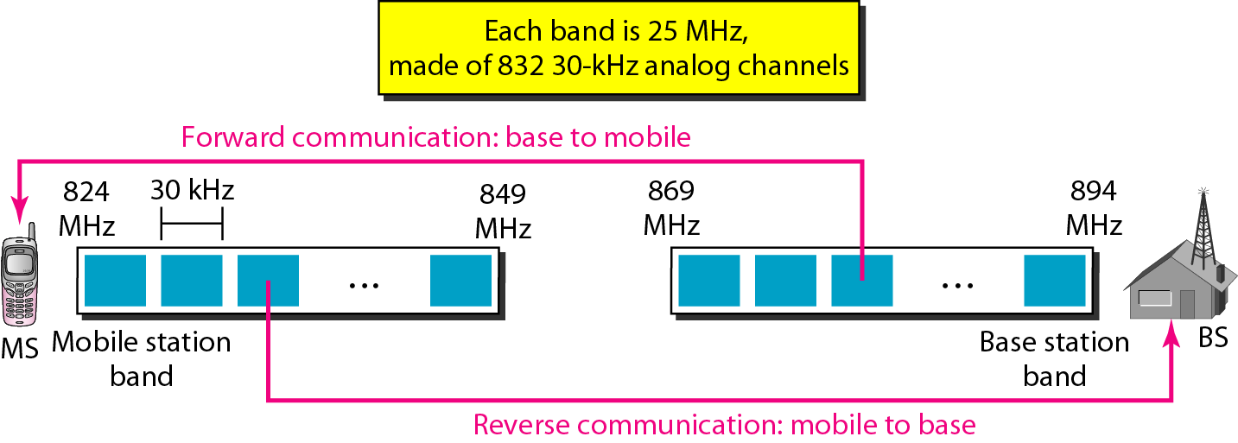
Figure 16.3 Cellular bands for AMPS

Slide 8
Advanced Mobile Phone System (AMPS)
Each band is divided into 832 channels.
Two providers can share an area, which means 416 channels in each cell for each provider.
Out of these 416, 21 channels are used for control, which leaves 395 channels.
AMPS has a frequency reuse factor of 7; this means only one-seventh of these 395 traffic channels are actually available in a cell.
Transmission AMPS uses FM and FSK for modulation.
Voice channels are modulated using FM, and control channels use FSK to create 30-kHz analog signals.
AMPS uses FDMA to divide each 25-MHz band into 30-kHz channels.

Slide 9
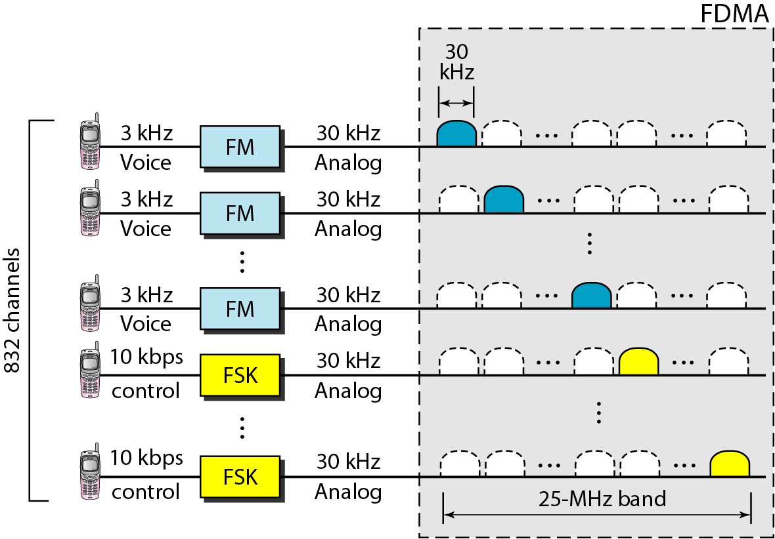
Figure 16.4 AMPS reverse communication band

Slide 10
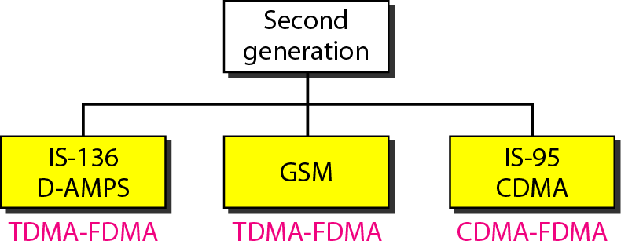
Second-generation cellular phone systems
To provide higher-quality (less noise-prone) mobile voice communications, the second generation of the cellular phone network was developed.
mainly designed for digitized voice.

Slide 11
D-AMPS
evolution of the analog AMPS into a digital system is digital AMPS.
Each voice channel is digitized using a very complex PCM and compression technique.
A voice channel is digitized to 7.95 kbps.
For example, Three 7.95-kbps digital voice channels are combined using TDMA. The result is 48.6 kbps of digital data.

Slide 12
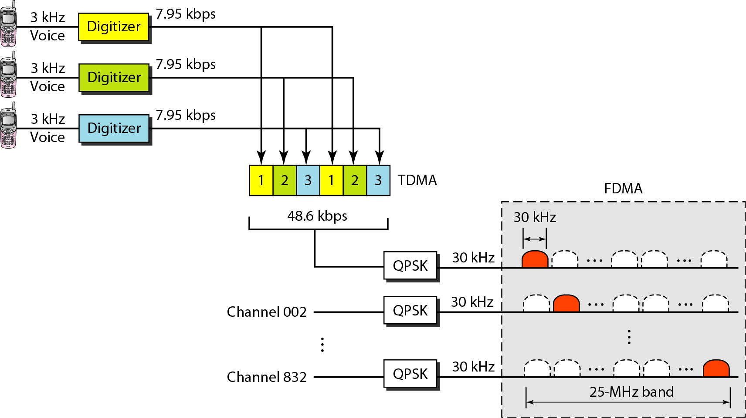
Figure 16.6 D-AMPS

Slide 13

Note
D-AMPS, or IS-136, is a digital cellular phone system using TDMA and FDMA.

Slide 14
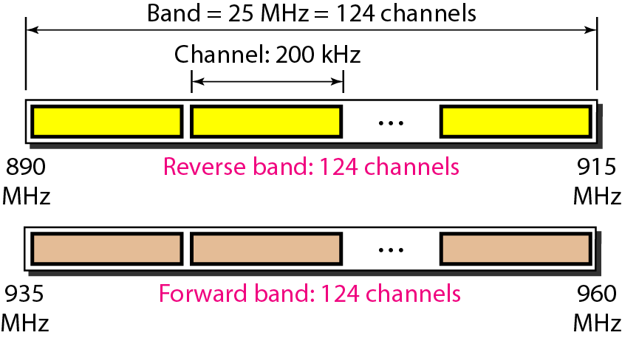
Figure 16.7 GSM bands

Slide 15
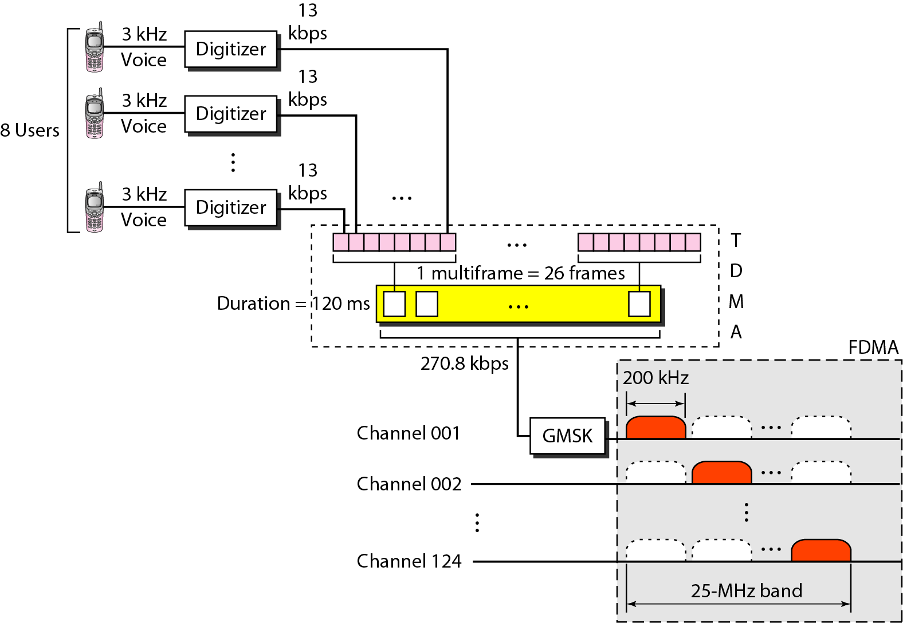
Figure 16.8 GSM

Slide 16
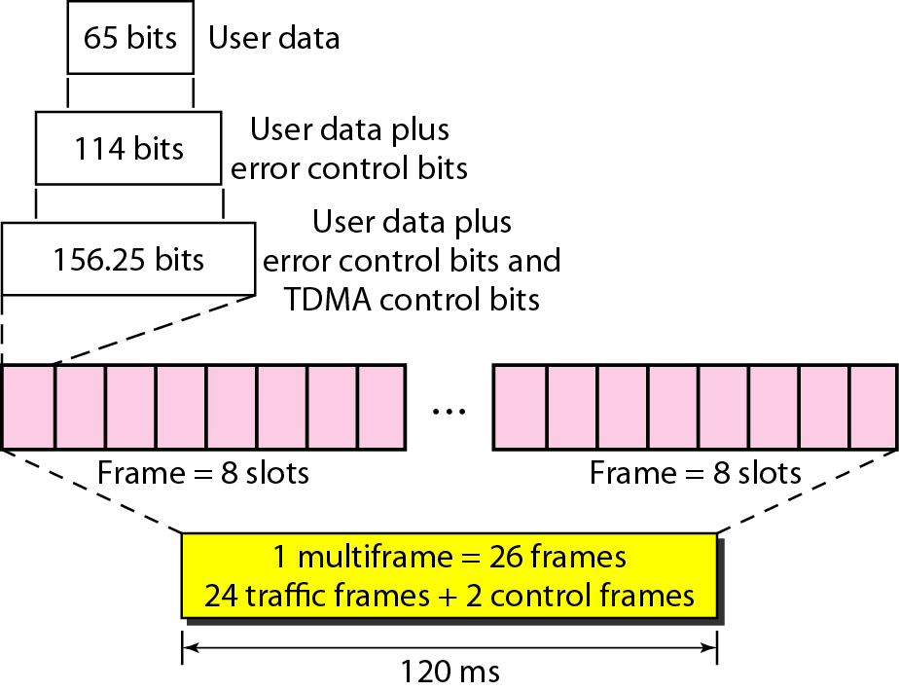
Figure 16.9 Multiframe components

Slide 17
Note
GSM is a digital cellular phone system using TDMA and FDMA.

Slide 18
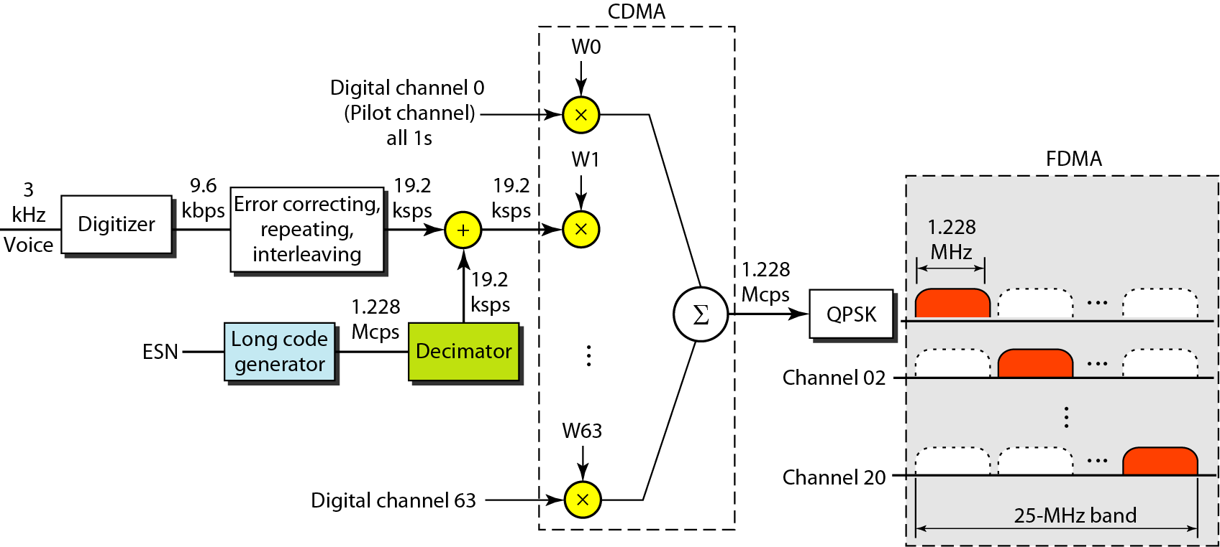
Figure 16.10 IS-95 forward transmission

Slide 19
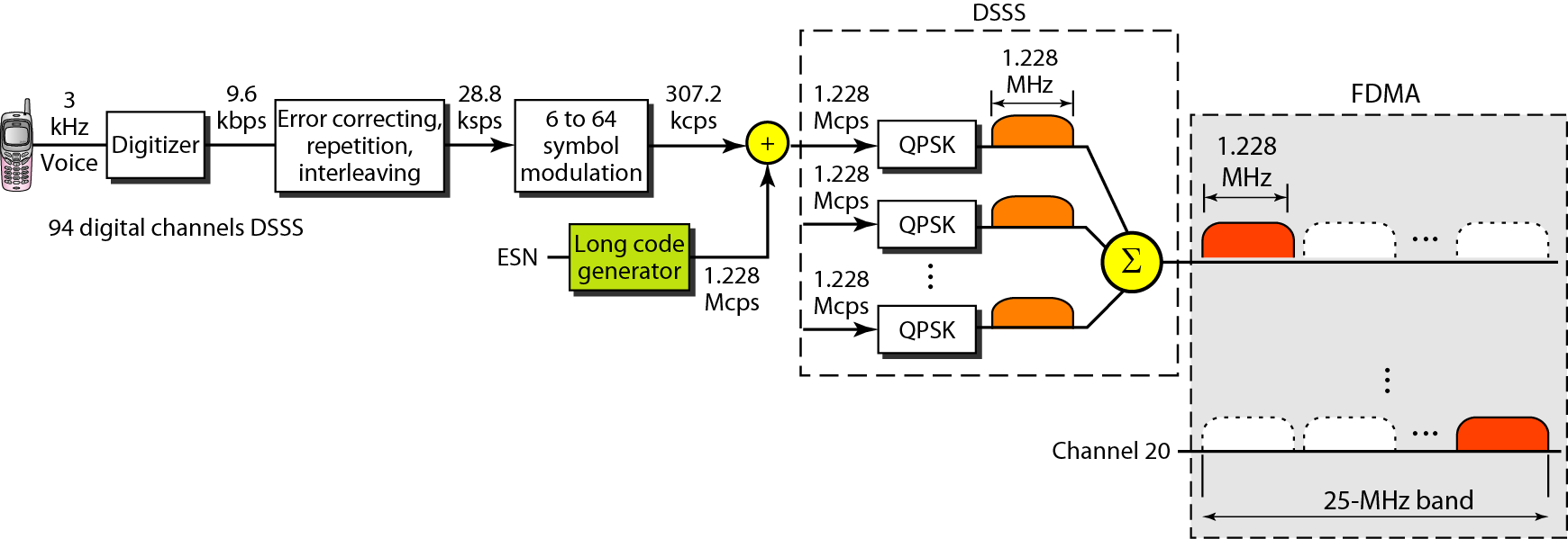
Figure 16.11 IS-95 reverse transmission

Slide 20
Note
IS-95 is a digital cellular phone system using CDMA/DSSS and FDMA.

Slide 21
Note
The main goal of third-generation cellular telephony is to provide
universal personal communication.

Slide 22
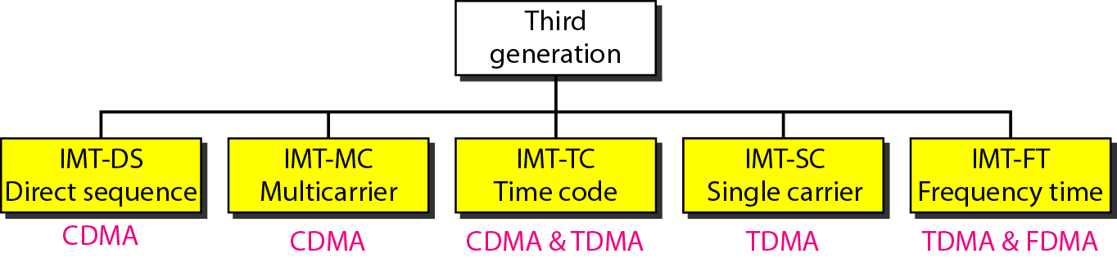
Figure 16.12 IMT-2000 radio interfaces

Slide 23

Reference
Chapter 16
Wireless WANs: Cellular Telephone
and Satellite Networks
Copyright © The McGraw-Hill Companies, Inc. Permission required for reproduction or display.

